Slide 1
Speed Up DNA Sequence Database Search and Alignment by Methods of DSP
Student: Kang-Hua Hsu 徐康華
Advisor: Jian-Jiun Ding 丁建均
E-mail: r96942097@ntu.edu.tw
Graduate Institute of Communication Engineering
National Taiwan University, Taipei, Taiwan, ROC
DISP@MD531

Slide 2
Outline
What is Bioinformatics?
Sequence alignment
Brute force method
Dynamic programming
Heuristic method
FASTA
BLAST
Our method
Conclusion
Future work
Reference
DISP@MD531

Slide 3
What is Bioinformatics?
One of the motivations: Similar sequences usually have similar functions, so we try to search for similarities between sequences.
→ Alignment & Database search
Problem: Huge data amount of DNA sequences,
composed of A、G、T、C.
(also protein sequences)
Solution: Computer
DISP@MD531

Slide 4
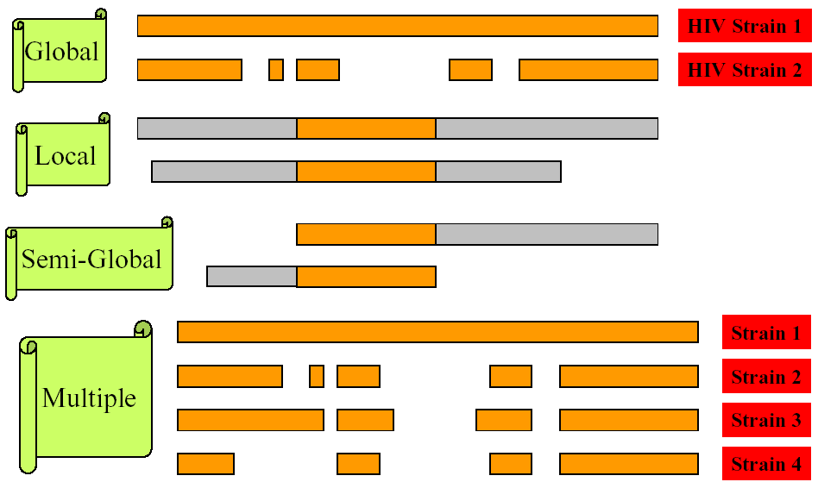
Sequence alignment(1)
DISP@MD531

Slide 5
Sequence alignment(2)
EX. Global alignment of
ＣＴＴＧＡＣＴＡＧＡ
and
ＣＴＡＣＴＧＴＧＡ
Result:
ＣＴＴＧＡＣＴ－ＡＧＡ
ＣＴ－－ＡＣＴＧＴＧＡ
Deletion
Insertion
Substitution
DISP@MD531

Slide 6
Dynamic programming
Figure out optimal sequence alignment(s).
Steps:
Recurrence relation
Tabular computation
Traceback
Problem: Inefficient & much memory
→ O(MN) : bad for long sequences
Solution: Heuristic method
→ FASTA & BLAST
or… our method
DISP@MD531
Notes:
步驟細節就略過了

Slide 7
Heuristic method
Screen phase:
We first pick out the most similar sequences in the database.
Dynamic programming:
Use the dynamic programming to further access the similarities of the picked out database sequences.
DISP@MD531
Notes:
步驟細節就略過了

Slide 8
FASTA
1. Look-up table for k-tuple words. (k = 4 to 6)
Ex. TGACGA & ATGAGC, k=2.
Word | Pos.1 | Pos. 2 | Offset
TG | 1 | 2 | -1
GA | 2 | 3 | -1
AC | 3 |  | X
CG | 4 |  | X
GA | 5 |  | X
AG |  | 4 | X
GC |  | 5 | X
AT |  | 1 | X
……
DISP@MD531

Slide 9
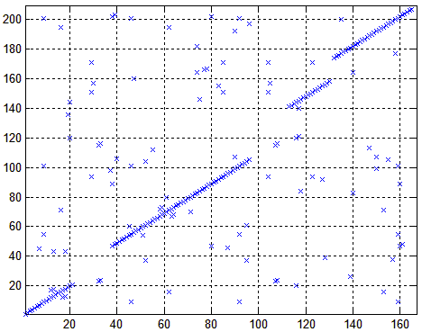
One X means one k-tuple word match
DISP@MD531

Slide 10
FASTA
2. Find the 10 “best”(high-scoring) diagonal regions.
Note: If there is a long gap of a diagonal, we would cut it into 2 diagonal lines.
 | A | G | T | C
A | 1 | -5 | -5 | -5
G | -5 | 1 | -5 | -5
T | -5 | -5 | 1 | -5
C | -5 | -5 | -5 | 1
DISP@MD531

Slide 11
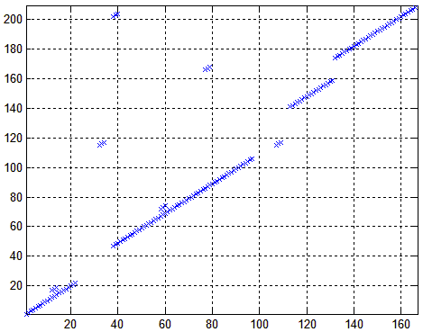
DISP@MD531

Slide 12
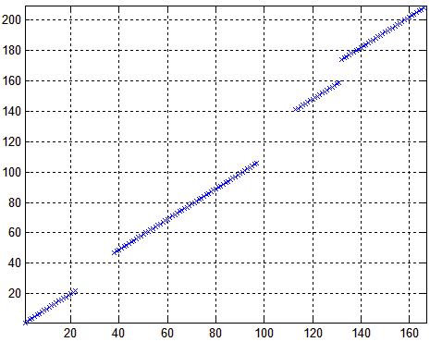
FASTA
3. Keep only the most high-scoring diagonal regions.
Keep the ones whose score is greater than a threshold.
DISP@MD531

Slide 13
FASTA
4. Try to join these remained diagonal regions into a longer alignment.
Score of the longer region =
SUM(scores of the individual regions) – Gap penalties
Search for the longer region(initial region) with
maximal score(INITN score).
DISP@MD531

Slide 14
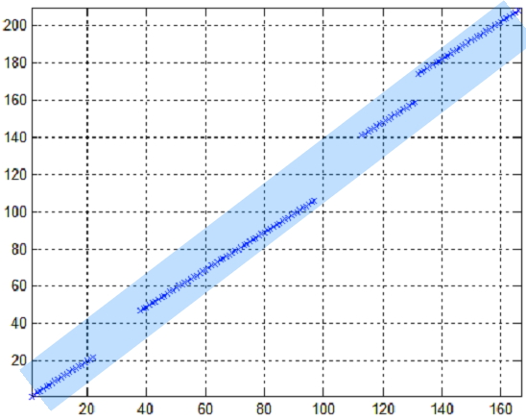
DISP@MD531

Slide 15
FASTA
5. Perform a local alignment by the dynamic programming, and obtain the optimized score.
If the INITN score is greater than a threshold, we perform a local alignment between a 32 residue wide region centered on the best initial region and the query sequence.
DISP@MD531

Slide 16
FASTA
6. Evaluate the significance of the optimized score.
Lower E value, higher significance.
DISP@MD531

Slide 17
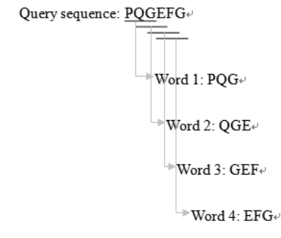
BLAST
1. Make a k-tuple word list of the query sequence.
DISP@MD531

Slide 18
BLAST
2. List the high-scoring words for each k-tuple words of the query sequence.
Score by substitution matrix.
PQG ↔ PEG = 15, PQG ↔ PQA = 12
If threshold T =13, we only care about PEG in the database sequences.
DISP@MD531

Slide 19
BLAST
3. Scan the database sequences for exact match with the remaining high-scoring words.
Such as PEG
DISP@MD531

Slide 20
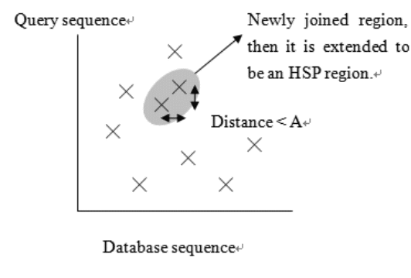
BLAST
4. Extend the exact matches to high-scoring segment pair (HSP).
DISP@MD531

Slide 21
BLAST
5. List all of the HSPs in the database whose score is high enough to be considered.
cutoff score S
DISP@MD531

Slide 22
BLAST
6. Access the significance of the HSP score.
Score of random sequences: Gumbel EVD
7. Local alignments of the query and each of the matched database sequences
8. Report the most possible significant database sequences.
DISP@MD531

Slide 23
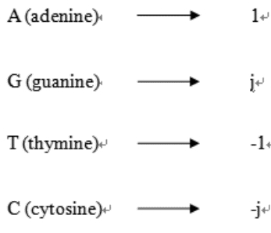
Our method
1. Unitary mapping.
2. UDCR (Unitary Discrete CorRelation)algorithm : estimates the better-aligned location.
If not found, insignificant.
DISP@MD531

Slide 24
Our method
3. UDCR (better aligned location) + Dynamic programming (alignments in detail) = CUDCR(Combined UDCR) algorithm
Only for semi-global and local alignments, not for global.
Discrete correlation is implemented by FFT or NTT, faster.
DISP@MD531

Slide 25
Our method
Remember that
O(MN) of dynamic programming
By CUDCR, O(MN) can be significantly reduced, because we input shorter sequences to the dynamic programming.
DISP@MD531

Slide 26
Conclusion
UDCR for estimating the better-aligned location.
CUDCR for local and semi-global alignments in detail.
Our method is faster than other methods with the same accuracy.
DISP@MD531

Slide 27
Future Work
Perform FASTA, BLAST and our method by C language.
Try to further speed it up.
Compare our method with other method more impersonally.
DISP@MD531

Slide 28
Reference
[1] J. Setubal and J. Meidanis, Introduction to Computational Molecular Biology, PWS Pub., Boston, 1997.
[2] Pearson W. R., Lipman D. J., Improved tools for biological sequence comparison. Proc Natl Acad Sci U S A. 85, 2444-2448, 1988.
[3] S. F. Altschul, W. Gish, W. Miller, E. W. Myers, and D. J. Lipman, “Basic local alignment search tool”, J. Mol. Biol., vol. 215, pp. 403-410, 1990.
[4] D. Gusfield, Algorithms on Strings, Trees, and Sequences. Cambridge University Press, 1997.
[5]http://binfo.ym.edu.tw/ib/courses/course_94_2/advanced_bioinformatics.htm
DISP@MD531

